Slide 1
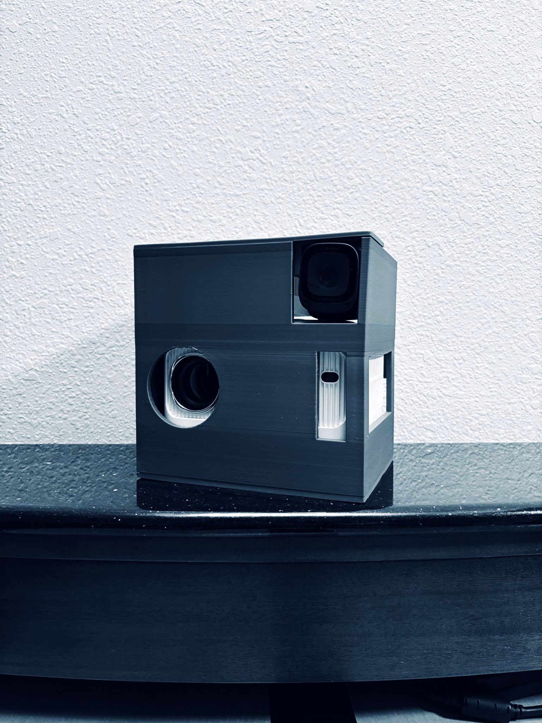
AirBoard -
IgnitionHacks
Hands-Free Presentation Device

Slide 2
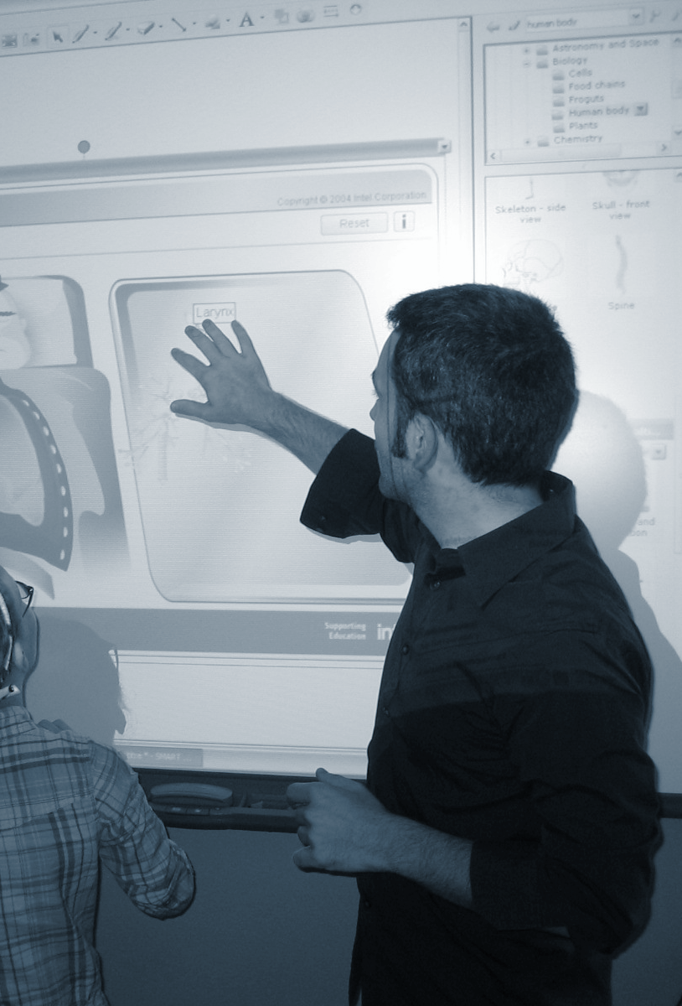
Problem
Traditional presentation devices are immobile and expensive
SMART Boards are upwards of $5000 per installation (SMARTBoards, 2024)
Only 26% of classrooms have access to these devices (Today’s Parent, 2017)

Slide 3

Solution
The AirBoard, a cheap portable alternative at under $700 for a pilot product
Hands-only control of Presentations, Drawing and more
No reliance on massive instalments or wiring

Slide 4

How it Works
Calibration
Modes
Universal Control

Slide 5
Drawing

Slide 6
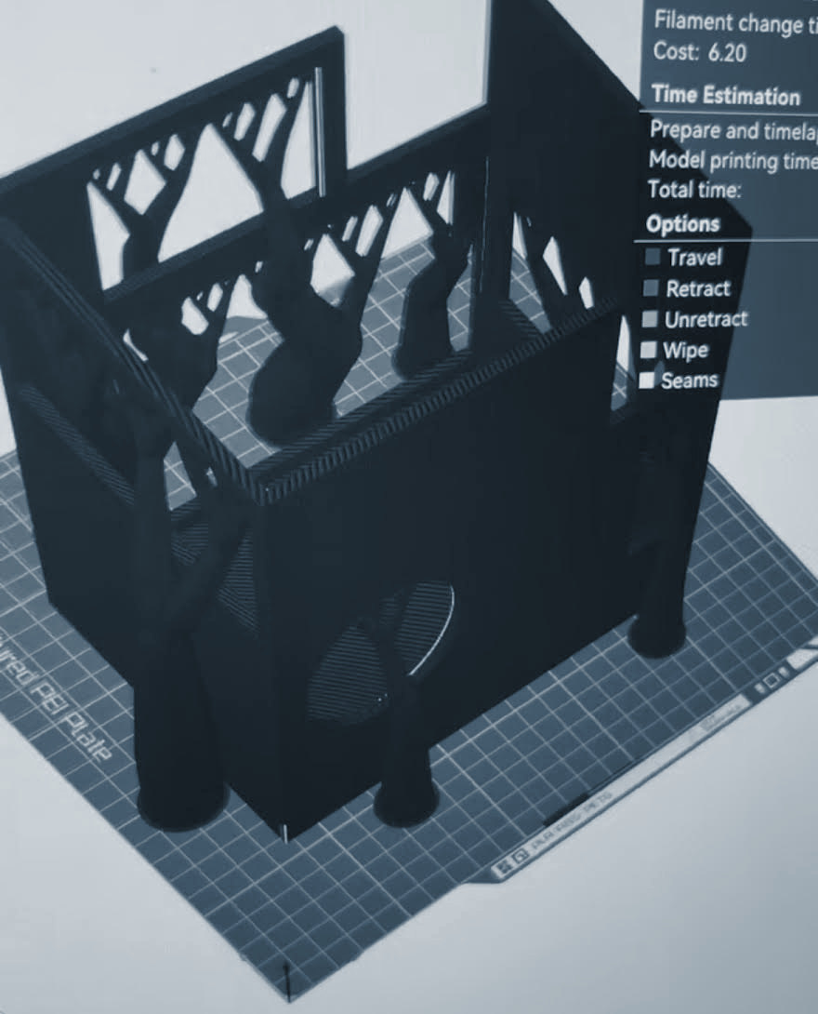
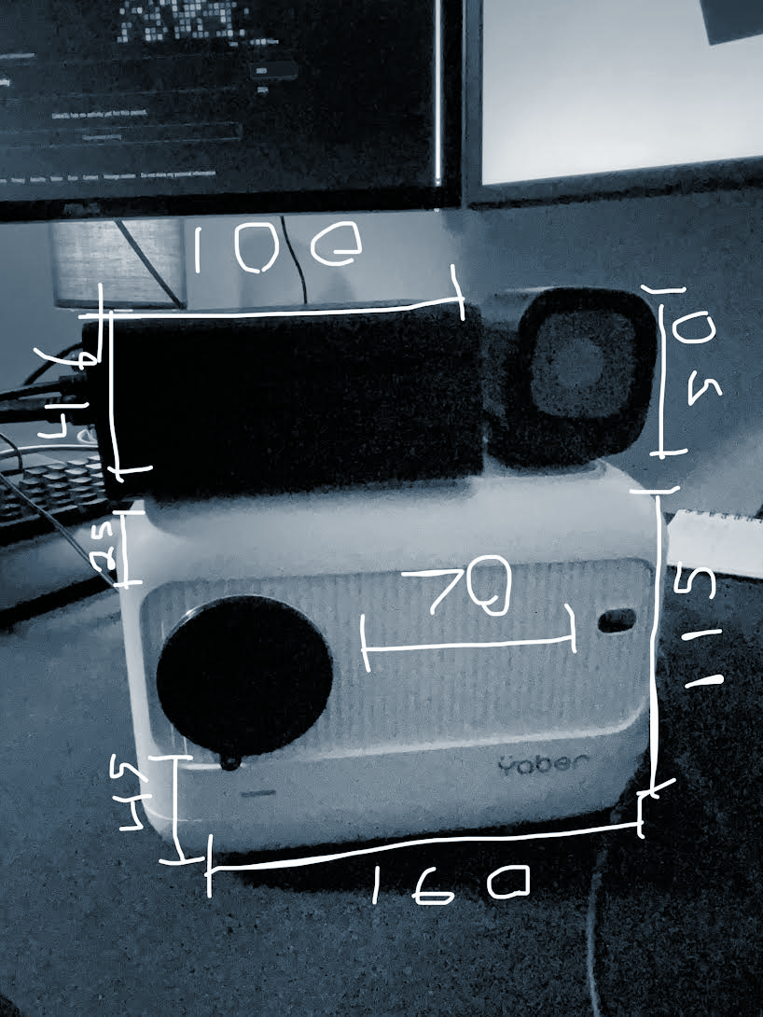
Technology
Modded Jetson Orin Nano
Miniature Projector
Anker High Res Camera

Slide 7
Future Enhancements
Customizable
Wireless
Efficiency
Custom training to only follow directions from selected people
Bluetooth connection from host computer to projector system
A “lite” version to attach to existing projectors to ease integration

Slide 8
Q&A
Please ask your questions or test the product!

Slide 9
Thank you!

